Slide 1


FlyNet: Mid Semester Review
October 21st, 2015
Critical Design Review

Slide 2
Overview
Project Overview
Organizational Chart
Concept of Operations
System Overview
Subsystem Overviews
Hardware Platform
Flight Controls / Autopilot Interfacing
Perception and Mapping
Target Identification
Planning and Guidance
End of semester demo
Deliverables
Requirement Updates
Budget
Schedule

Slide 3
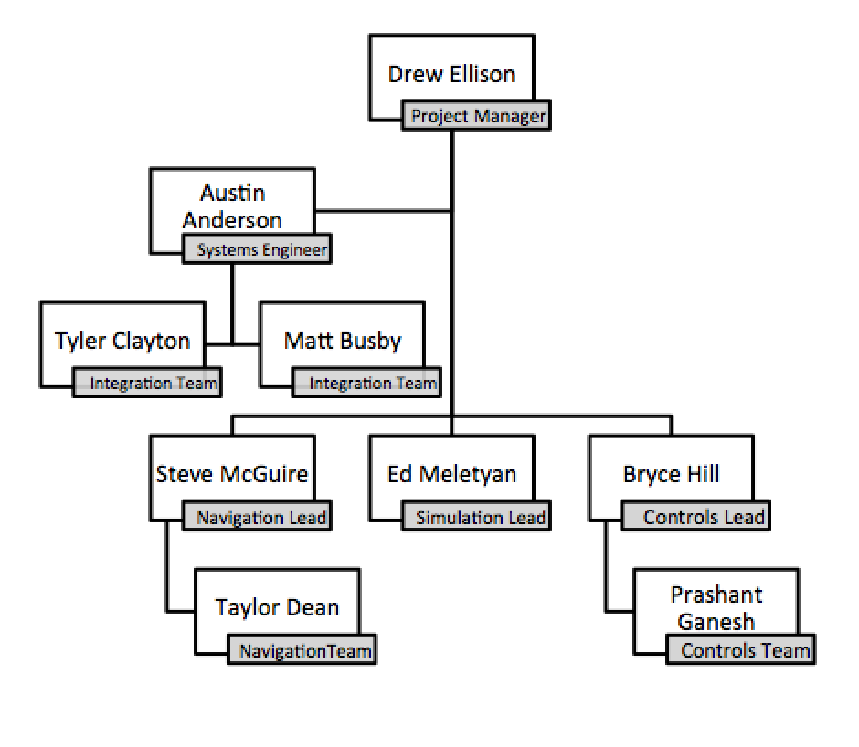
Organization Chart

Slide 4
Organization Chart

Slide 5
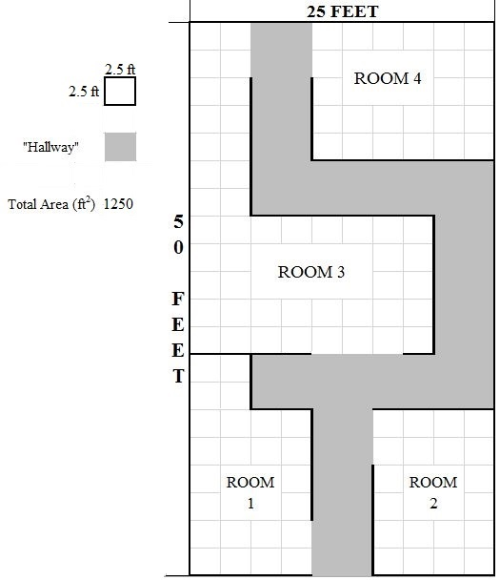
Concept of Operations
Autonomously explore an indoor environment with a team of ground/air robots in a disaster area situation
Map the environment and communicate that map to first responders
Identify humans in the environment and report their locations to first responders
Deliver a package to humans in the environment
“Roadblock”
“Target”
“Complete Block”
Entry/Exit Point

Slide 6
FlyNet: System Block Diagram
= Internal Software hosted on XU4
FLiR
Ground Station
= Off board system
= Sensor
Target Detection and Tracking
= Pixhawk
Guidance
SLAM
Planning
Flight Control
RC Overrides
= Internal software connection using ROS publish/subscribe
= SPI Video
= USB connection
= Wireless link

Slide 7
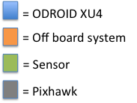
FlyNet: System Block Diagram
To SLAM:
5 x Grey-Scale Image @ 20 Hz
2 x Depth Map @ 20 Hz
Body Frame Velocity
(vN,vE,vD) @ 10 Hz
FLiR
Ground Station
To Planning:
5 x Obstacle distance @ 20 Hz
Target Detection and Tracking
Guidance
SLAM
Planning
Flight Control
RC Overrides

Slide 8
FlyNet: System Block Diagram
To Target D and T:
80x60 IR images @ 8.6 Hz
FLiR
Ground Station
Target Detection and Tracking
Guidance
SLAM
Planning
Flight Control
RC Overrides

Slide 9
FlyNet: System Block Diagram
To Planning:
Map (in octo-map representation) @ ~10 Hz
FLiR
Ground Station
To Planning and Flight Control:
Local NED @ ~10 Hz
To Target D and T:
Local NED @ ~10 Hz
Depth Map @ ~20 Hz
Target Detection and Tracking
Guidance
SLAM
Planning
Flight Control
RC Overrides
From Guidance:
See Guidance Slide
From Target D and T:
Target position estimate in local NED @ <8.6 Hz

Slide 10
FlyNet: System Block Diagram
To Planning, SLAM, Ground Station:
Target position estimate in local NED @ <8.6 Hz
FLiR
Ground Station
Target Detection and Tracking
Guidance
SLAM
Planning
Flight Control
RC Overrides
From FLiR:
80x60 IR images @ 8.6 Hz
From SLAM:
Local NED estimate @ ~10 Hz
Depth Map @ ~20 Hz
From Flight Control:
Attitude estimate in Euler Angles @ TBD Hz

Slide 11
FlyNet: System Block Diagram
To Flight Control:
POS Command in Local (or Global) NED @ Variable Hz
Attitude Command in Euler Angles @ Variable Hz
FLiR
Ground Station
Target Detection and Tracking
Guidance
SLAM
Planning
Flight Control
RC Overrides
From Target D and T:
Target Location Estimate @ <8.6 Hz
From SLAM:
Local NED estimate @ ~10 Hz, Map @ ~10 Hz
From Guidance:
5 x Obstacle distance @ 20 Hz
From Ground Station:
Operator Override Commands

Slide 12
FlyNet: System Block Diagram
To Target D and T:
Attitude estimate in Euler Angles @ TBD Hz
FLiR
Ground Station
Target Detection and Tracking
Guidance
SLAM
Planning
Flight Control
RC Overrides
From Planning:
Set-points (see planning slide)
From SLAM:
Local NED estimate @ ~10 Hz, Map @ ~10 Hz
From RC Overrides:
Arm signal
Max throttle control
From Guidance (TBD):
1 x Sonar distance @ 20 Hz

Slide 13
FlyNet: System Block Diagram
FLiR
Ground Station
Target Detection and Tracking
Guidance
SLAM
Planning
Flight Control
RC Overrides

Slide 14
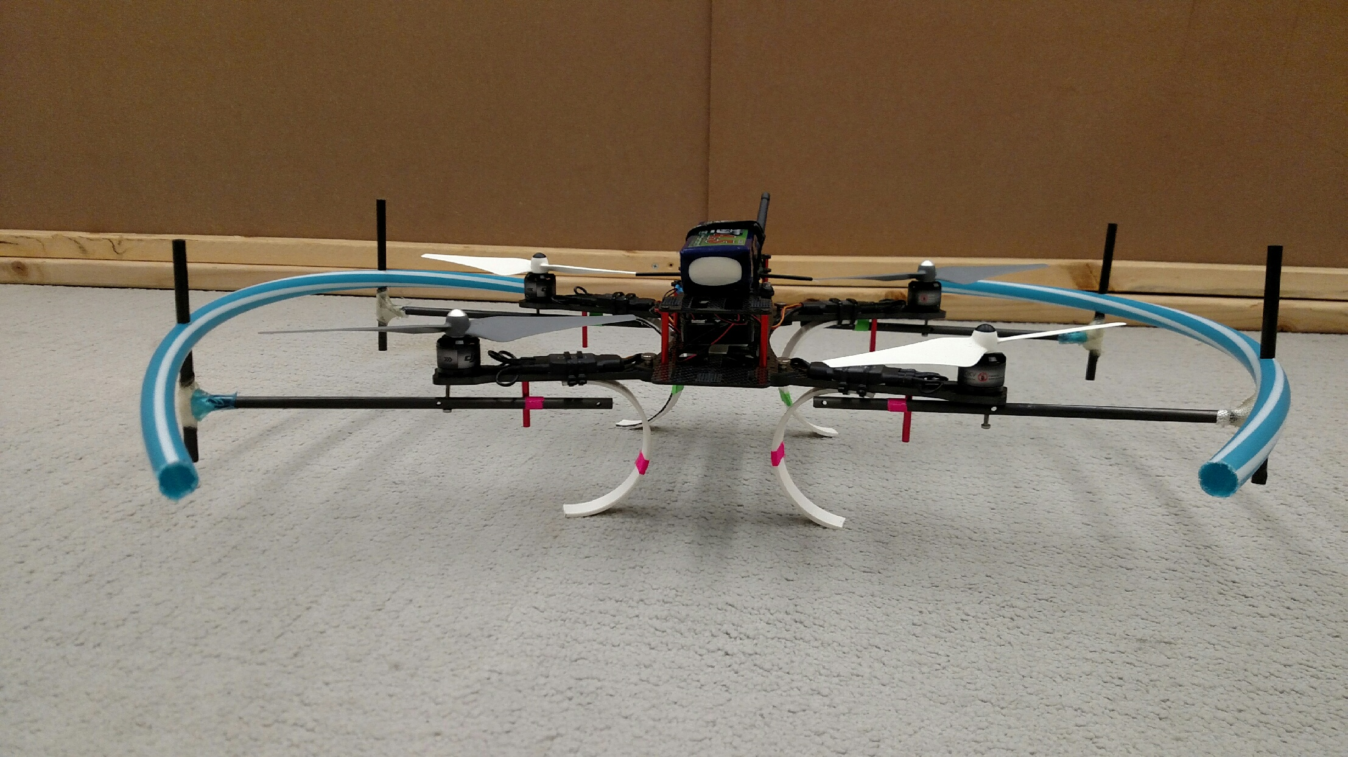
Hardware Platform
Requirement Motivation:
The system shall search a 50,000 ft² indoor environment.
The system shall maintain flight for at least 10 minutes.
The system shall carry an additional payload to be delivered.
Proposed Solution (1st iteration) :
Aliencopter Bee Quadcopter
Guidance sensor suite

Slide 15
AlienBee Power and Mass Budgets
Item | QTY | Mass [g] | Curr [mA] | [mW]
Turnigy Nano-Tech LiPo Battery | 1 | 482.7 | -- | --
Odroid XU4 | 1 | 64.2 | 800 | 4000
3DR Radio | 1 | 26.2 | 100 | 330
Pixhawk | 1 | 40.3 | 175 | 1500
FLIR Lepton LWIR Camera | 1 | 0.55 | 5 | 150
Customer Payload (1lb) | 1 | 453.59 | -- | --
AlienBee Quad (Motor, Structure) | 1 | 43 | -- | --
DJI 9443 Propellor (E300) | 4 | 19 | -- | --
Guidance | 1 | 291 | 540 | 12000
ASUS Xtion Pro Live – RGBD camera | 1 | 115 | 500 | 2500
LIDAR-Lite v2 | 1 | 28.1 | 100 | 550
Windows Lifecam Studio Camera | 1 | 128 | 500 | 2500
TOTAL - Guidance |  | 2380 | 1670 | 17980
TOTAL - RGBD |  | 2360 | 2230 | 11530

Slide 16
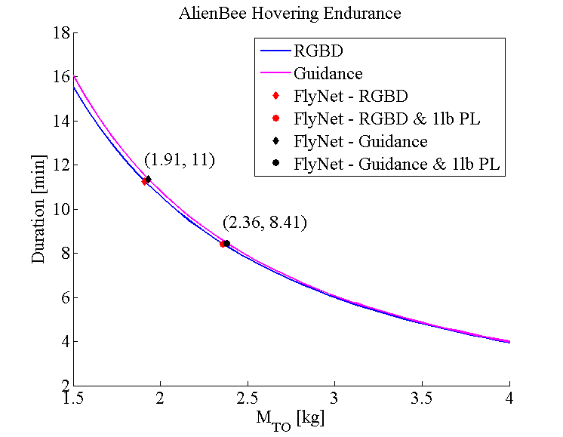
AlienBee Endurance vs. Payload

Slide 17
FlyNet: Autonomous Quadcopter Search and Rescue
System | Mass Normal (1lb PL) [kg] | Endurance [min] | Endurance w/ 1lb PL [min]
AlienBee w/ RGBD | 1.91 (2.36) | 11.3 | 8.4
AlienBee w/ Guidance | 1.93 (2.38) | 11.4 | 8.5
Time [min] | 8 | 10 | 11
Min Speed [m/s] | 2.31 | 1.85 | 1.67

Slide 18
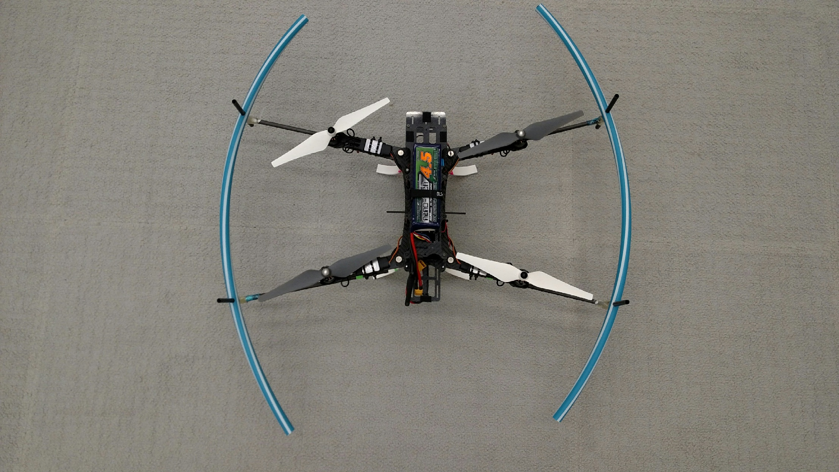
AlienBee Copter with Custom Modifications
Custom blade guards created from a Hula Hoop
Custom Plastic
Landing Gear

Slide 19
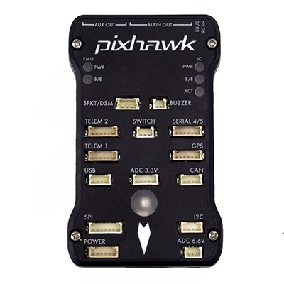
Autonomous Quadcopter Control
Requirement Motivation:
The system shall perform a search for targets in unknown environments with limited prior information.
The system shall be completely autonomous after mission initialization.
Proposed Solution (1st iteration) :
Onboard single board computer (SBC) to perform planning and navigation calculations.
Interface with Pixhawk autopilot and use onboard controllers for position/velocity control
Trajectory planning and obstacle avoidance will be done on the onboard companion computer, position and velocity setpoints sent to autopilot
If onboard controllers are not sufficient, modifications will be made to onboard controls architecture

Slide 20
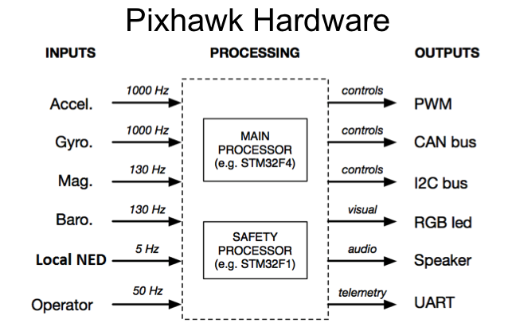
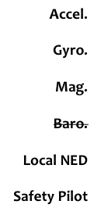
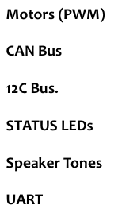
Pixhawk Functionality
https://pixhawk.org/

Slide 21
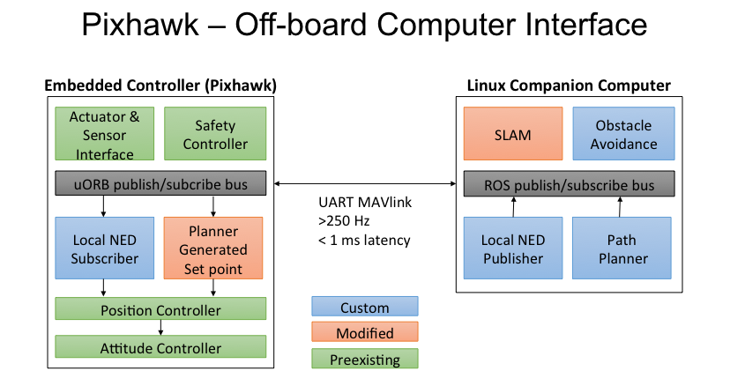
Onboard Computer – Pixhawk Interface

Slide 22
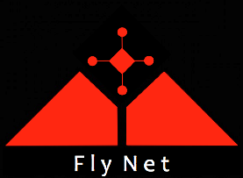
Pixhawk Control Architecture
Position Control
Attitude Control
Position Control
Position Rate Control
Attitude Rate Control
Position setpoint
Attitude setpoint
Multirotor Mixer
Horizontal
Control
Horizontal Rate Control
Attitude Control
Roll Rate
Euler Angles
X, Y, Z
Roll, Pitch, Yaw, Throttle
Pitch Rate
Vertical
Control
Altitude Control
Yaw Rate
Manual RC
Overrides
Manual RC
Overrides
Current position and velocity
Euler rotation matrix
Velocity estimate
(Optional)
Velocity
Position Estimator
Attitude Estimator
Attitude
Accelerometer
GPS
Sonar
Accelerometer
Gyro
Magnetometer
Based on Diagram from: https://pixhawk.org/dev/multirotor/start

Slide 23
Pixhawk Control Architecture
Position Control
Attitude Control
Position Control
Position Rate Control
Attitude Rate Control
Position setpoint
Attitude setpoint
Multirotor Mixer
Horizontal
Control
Horizontal Rate Control
Attitude Control
Roll Rate
Euler Angles
X, Y, Z
Roll, Pitch, Yaw, Throttle
Pitch Rate
Vertical
Control
Altitude Control
Yaw Rate
Manual RC
Overrides
Manual RC
Overrides
Current position and velocity
Potential Entry Point for SLAM Local NED Estimates
Euler rotation matrix
Velocity estimate
(Optional)
Velocity
Position Estimator
Attitude Estimator
Attitude
Accelerometer
GPS
Sonar
Accelerometer
Gyro
Magnetometer
Based on Diagram from: https://pixhawk.org/dev/multirotor/start

Slide 24
Localization and Mapping
Requirement Motivation:
The system shall perform a search for targets in unknown environments with limited prior information.
Vehicles shall maintain a map of obstacles.
Vehicles shall communicate maps with other autonomous agents and with human responders (post mission).
Proposed Solution (1st iteration) :
Guidance sensor suite by DJI
Visual odometry with IMU Fusion
Obstacle detection
RTAB Map ROS Package
Mapping and localization refinement.
Produces a metrically accurate 3-D map of the world while estimating observation location and motion in that map.

Slide 25
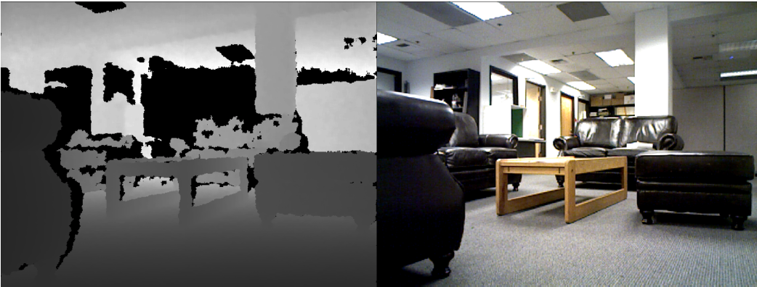
Perception Sensor Suite
Inertial 6DOF inertial data is available with calibration parameters
Depth Dense metric depth imagery is available with a pinhole camera model
Visual Imagery is available with a pinhole camera model

Slide 26
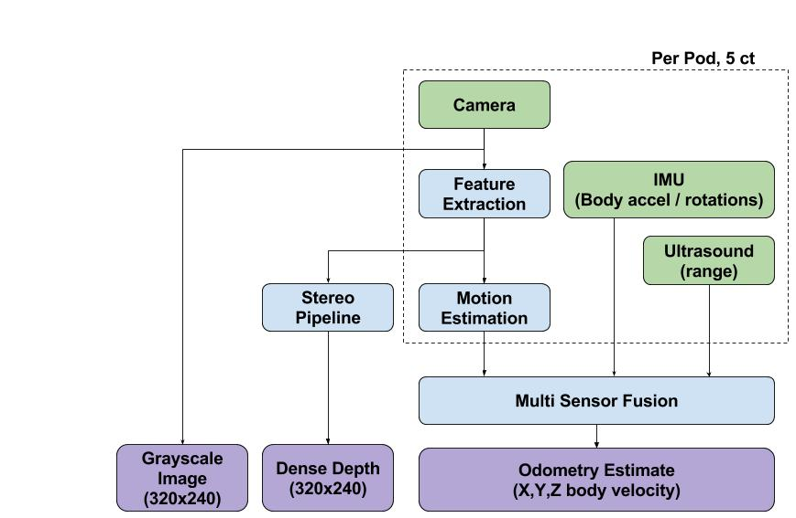
Perception Architecture

Slide 27
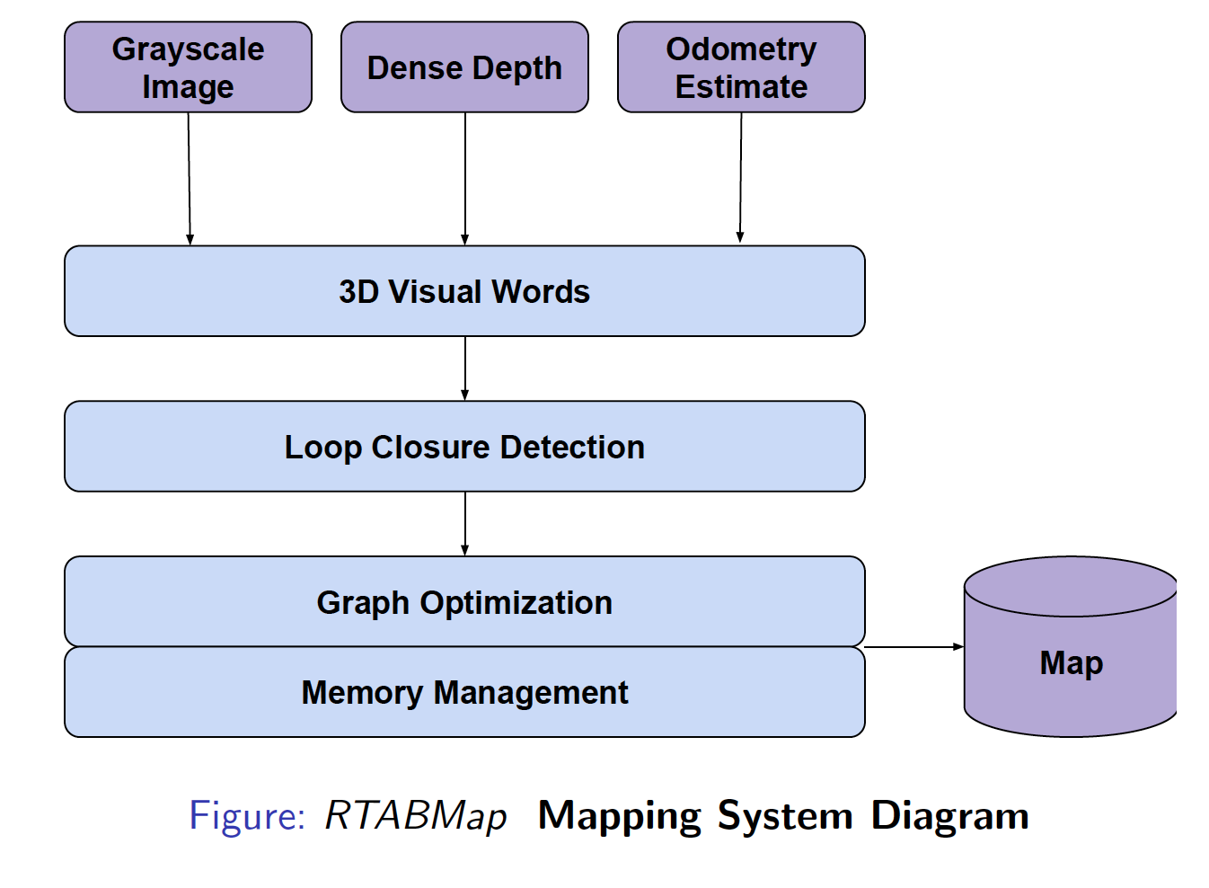
Mapping Architecture

Slide 28
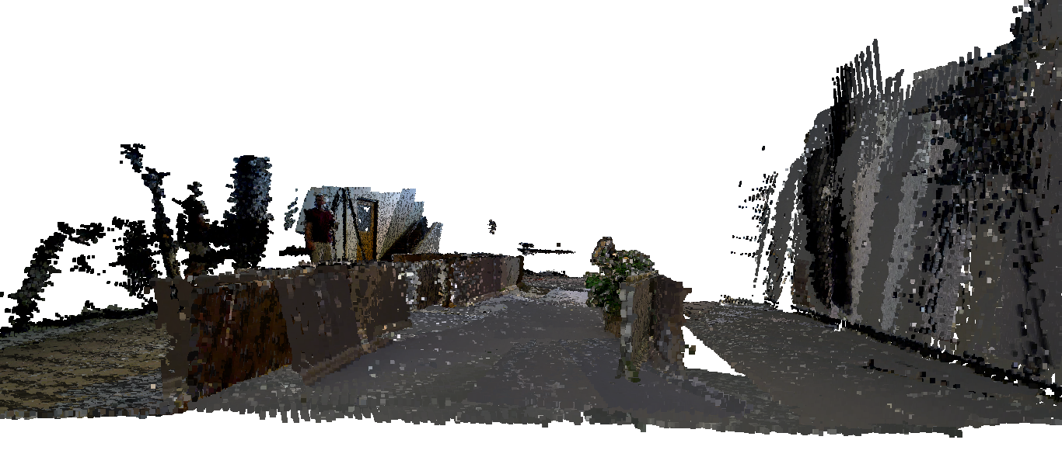
Mapping Architecture
Front view of Fleming Lab created using RTAB Map

Slide 29
Alternative SLAM Options
LSD-SLAM: Large Scale Dense SLAM: Requires scale parameter estimation external to the system to produce a metric map
RGBD-SLAM: Does not provide for loop closure detection (worse map quality in larger spaces)
Notes:
Add actual map quality metrics here.

Slide 30
Autonomous Target Identification
Requirement Motivation:
The system shall identify targets within 5 meters of a vehicle
The system shall track visually identified targets.
Proposed Solution (1st iteration) :
FLiR Long wave infrared camera for identification of humans
OpenCV packages for Target ID
Custom Multiple Hypothesis tracker for tracking multiple targets in frame
Integration with sensor pose and motion estimates

Slide 31
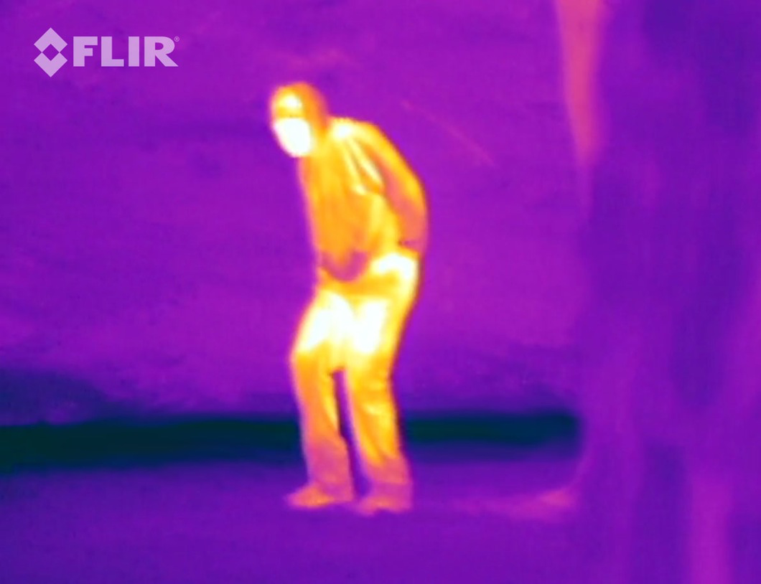
Tracking Method
Must process images at >= 5 Hz
Use C++ and OpenCV for low-overhead image processing
OpenCV has significant documentation and many useful libraries
OpenCV used in conjunction with Multiple Hypothesis Tracking (MHT) and Kalman Filtering will provide quick and accurate tracking solutions
Preliminary Sensor: Lepton 80x60 Pixel LWIR camera
Provides contrast between human and background
http://www.gizmag.com/flir-iphone-thermal-imaging/30447/pictures#3

Slide 32
Tracking Architecture
Track Identifier
FLiR Camera Image Data
(80x60 pixel map)
Fused Sensor Velocity and Attitude Data
Object Level Tracker (Localizer)
Groundstation
Vehicle Map Position
(Local NED)
Tracking Subystem
Time-synced Depth Image
Depth to FLiR Transformation (Calibration)
Perception Subsystem

Slide 33
Planning and Guidance
Requirement Motivation:
The vehicle shall avoid unrecoverable collisions with obstacles.
The system shall plan vehicle trajectories through the environment.
The vehicle shall move through the environment along planned trajectories to within TBD RMS error of the planned trajectory.
The aerial vehicle shall maintain a minimum distance of TBD from obstacles.
Proposed Solution (1st iteration) :
Generate precomputed trajectories from prior map in 2D.
Use obstacle distances from Guidance to trigger replanning.
Use updated maps from SLAM in replanning.
Support multiple guidance modes based on regimes of operation
Target localization
Door entry
Featureless hallways

Slide 34
FlyNet: Planning
Generate initial path to explore space
Plan path for feasible dynamics
Plan path to avoid obstacles
Efficiently search space

Slide 35
FlyNet: Planning
Generate initial path to explore space
Plan path for feasible dynamics
Plan path to avoid obstacles
Efficiently search space
Discover unknown obstacles
“Roadblock”
“Target”
“Complete Block”

Slide 36
FlyNet: Planning
Generate initial path to explore space
Plan path for feasible dynamics
Plan path to avoid obstacles
Efficiently search space
Discover unknown obstacles
Update plan based on dynamic environment
“Roadblock”
“Target”
“Complete Block”

Slide 37
FlyNet: Planning
Path Planning Alternatives
Cell Decomposition
Break the map down into a grid
Determine valid connections in the grid space
Easy/fast to compute
Cannot capture complex vehicle dynamics
Potential Fields
Generate potential fields for plan
Attract to desired trajectory
Repel from obstacles
Easy/fast to compute
Struggles with local minima (ie rooms)
Sampling based methods
Sample potential robot states randomly
Connect states by checking for collisions and dynamics feasibility
Captures high-dimensional robot states
Captures complex problem constraints
See: http://ompl.kavrakilab.org/OMPL_Primer.pdf

Slide 38
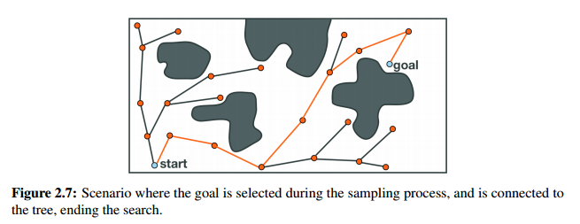
FlyNet: Planning
Path Planning Alternatives
Tree-Based Planners
Seed a tree at the origin
Randomly sample states near the current location
Connect to all valid states based on collision detection and dynamics
Grow this tree until we get to the goal
Generates a single path from start to goal
Need to grow a new tree for re-planning
From: http://ompl.kavrakilab.org/OMPL_Primer.pdf

Slide 39
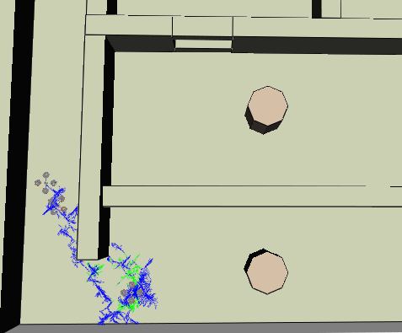
FlyNet: Planning
The Open Motion Planning Library
Open-source library with implementations of sample-based planning algorithms
Provides plug-ins to ROS or standalone c++
Supports basic modeling of quad rotors moving in 3D Environment
Uses point-mass model of quad with thrust and angular acceleration as controls
Environment is defined by CAD model
Initial path planning conducted for built-in environment using RRT
Top-Down View
Goal
Start
Trajectory

Slide 40
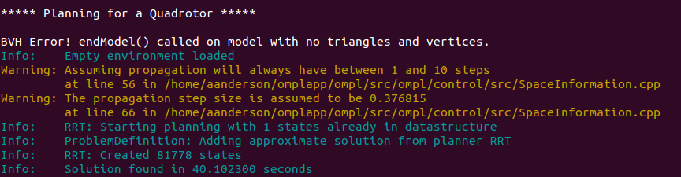
FlyNet: Planning
The Open Motion Planning Library
Supports benchmarking of planners
So far, 3D planners seem to take significant amounts of time:
40 seconds for an empty space!

Slide 41
FlyNet: Planning
Path Planning Issues
Path planning can generate a near optimal trajectory for getting between a start position and goal
Ability to plan with well known map can generate trajectories free of obstacles in highly complex environment
Require minimal human input
3D path planning can be time consuming

Slide 42
FlyNet: Planning
Path Planning Issues
Path planning can generate a near optimal trajectory for getting between a start position and goal <- We need to make the goals
Ability to plan with well known map can generate trajectories free of obstacles in highly complex environment <- Our environments contain uncertainties
Require minimal human input
3D path planning can be time consuming <- We will likely need to re-plan frequently

Slide 43
FlyNet: Planning
Block Diagram (In Development)
Feature Detection
Feature Mode
Mode Select
Target location estimate:
Local NED
Target Localization
POS Set-Point: NED
Local NED from SLAM
Command Mux
Attitude Set-Point: Ɵɸɣ
Obstacle Distance from Guidance
<
Trajectory Memory
Updated Map from SLAM
Re-Plan
A-priori MAP (CAD)
Offline Planner

Slide 44
FlyNet: Planning
Path Forward
Determine method for generating goal points
Base this on search coverage by projecting FLiR FoV
Explore options for 2D planning
Faster re-planning
Improve quadrotor model in OMPL
Give roll/pitch limits
Potentially eliminate orientation as a state for exploration
Benchmark various planning options in OMPL
Generate 3D or 2D model of our test space

Slide 45
FlyNet: End of Semester Test
Setup:
Known blueprint of area
Set up in Fleming Vicon Cage
Multiple rooms
Includes various hallway types
Dead end
Left turn
Right turn

Slide 46
FlyNet: End of Semester Test
Unknowns:
Three Roadblocks placed into map
4’ x 3’ wall
Placed into map
Target placed into map
One Complete Block placed into map
4’ x 6’ wall
Height of standard wall for test environment
“Roadblock”
“Target”
“Complete Block”

Slide 47
FlyNet: End of Semester Test
Tasks to Complete:
Explore entire map
Avoid all obstacles
Walls
“Roadblocks”
“Complete Blocks”
Return back to Entry Point with entire area mapped
“Roadblock”
“Target”
“Complete Block”
Entry/Exit Point

Slide 48
First Semester Deliverables
One platform explores the Fleming lab space (2 rooms in addition to the main space) from a fixed starting point
One room has a static, unknown person.
The target is identified and the position is reported to a ground station.
The quad will return to the starting position.

Slide 49
Unaddressed Requirements
Target tagging
QR Codes
Give more accurate positioning info than RFID Tags
Processed through grayscale images
Planned to address next semester
Multi Robots
Will evaluate single flying robot this semester
Budget provides overhead for at least 2 more based on current design
Exploring ground robots using borrowed Turtlebots
Examining architecture benefits
Multi Vehicle Coordination
Hooks built into planning
Need to explore offline planning algorithms
Need to explore efficient exploration algorithms
Planned to address next semester

Slide 50
Updated Requirements
Removed lighting requirements
Guidance only provides reliable performance in good lighting conditions
Benefits of Guidance to remaining requirements found to outweigh cost of removing lighting requirement
½ lb payload was found to give reasonable external payload budget while maintaining flight endurance requirements
Target ID rate requirement was reduced to 5Hz from 10Hz after reviewing available FLiR specs
Only the export control variant was available
This variant has a reduced frame rate

Slide 51
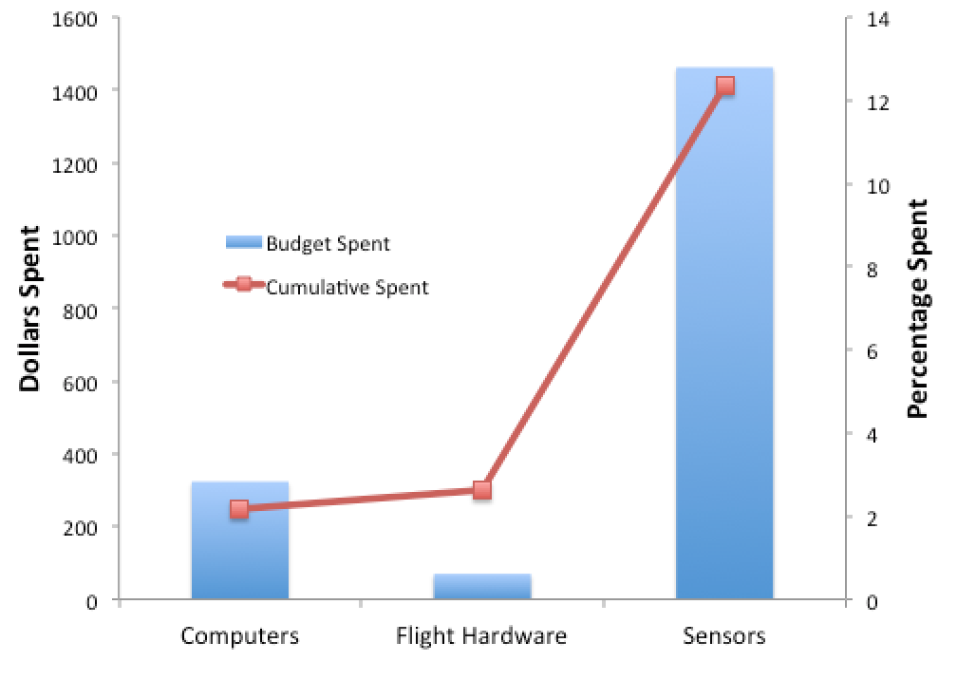
Budget
Currently Spent:
$1855.00 / 12.4%
Previous spending:
Quadrotor platform
Several single board computers (ODROID XU4)
Planned Spending:
Secondary platform:
Estimated to be $3000 per platform

Slide 52
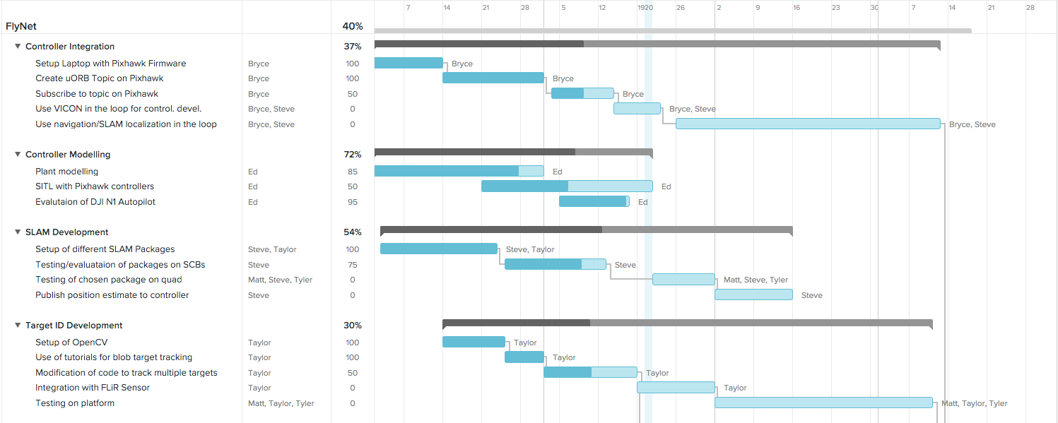
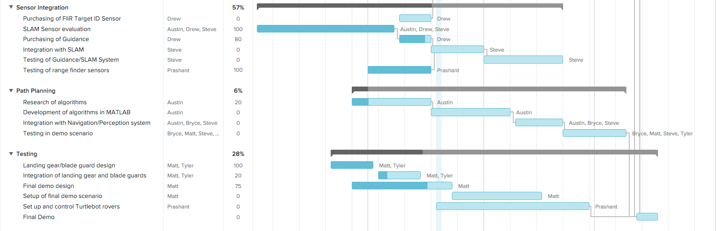
Schedule

Slide 53
Questions?

Slide 54
Back-up Slides

Slide 55
Algorithm Overview
Obtain Object Measurements
Generate Hypotheses
Prune Hypotheses
Correlate Hypotheses with Previous Feasible Tracks
Prune Feasible Tracks
Publish Confirmed Tracks

Slide 56
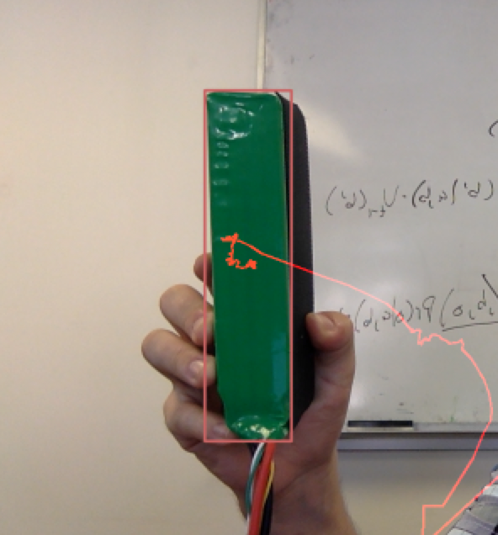
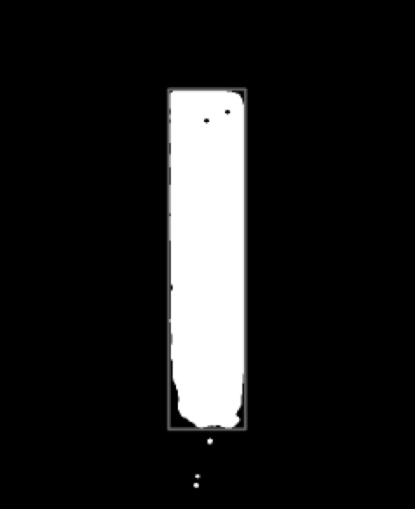
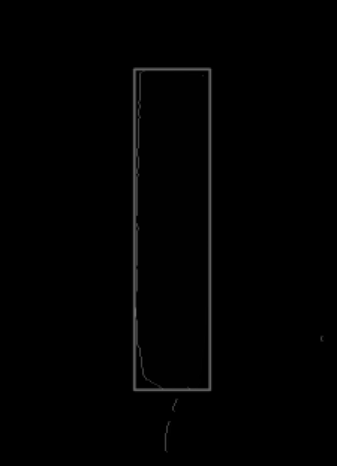
Obtaining Measurements from Images
Obtain Image
Mask Image
Find Contours
Save Features
Features:
Area
X Position
Y Position
Computed Features:
Δ Area
X Velocity
Y Velocity

Slide 57
Algorithm Overview
Obtain Object Measurements
Generate Hypotheses
Prune Hypotheses
Correlate Hypotheses with Previous Feasible Tracks
Prune Feasible Tracks
Publish Confirmed Tracks

Slide 58
Generating Hypotheses
Objects of interest are detected at t0
t0

Slide 59
Generating Hypotheses
New objects of interest are detected at t1 and they can be associated to form feasible tracks
t1

Slide 60
Generating Hypotheses
New objects of interest are detected at t1 and they can be associated to form feasible tracks
t1

Slide 61
Algorithm Overview
Obtain Object Measurements
Generate Hypotheses
Prune Hypotheses
Correlate Hypotheses with Previous Feasible Tracks
Prune Feasible Tracks
Publish Confirmed Tracks

Slide 62
Pruning Hypotheses
These may be down selected using a velocity constraint
t1

Slide 63
Pruning Hypotheses
This velocity constraint is used as follows:
t1

Slide 64
Pruning Hypotheses
Propagate the measurement’s state for one period:
t1

Slide 65
Pruning Hypotheses
Apply an error bound:
t1

Slide 66
Pruning Hypotheses
Prune hypotheses down to those that fit within velocity constraint
t1

Slide 67
Algorithm Overview
Obtain Object Measurements
Generate Hypotheses
Prune Hypotheses
Correlate Hypotheses with Previous Feasible Tracks
Prune Feasible Tracks
Publish Confirmed Tracks

Slide 68
Prune Feasible Tracks
Continue to form feasible tracks until tracks become improbable
t2

Slide 69
Algorithm Overview
Obtain Object Measurements
Generate Hypotheses
Prune Hypotheses
Correlate Hypotheses with Previous Feasible Tracks
Prune Feasible Tracks
Publish Confirmed Tracks

Slide 70
Prune Feasible Tracks
Track is terminated after no new correlated objects
t3

Slide 71
State Transition Matrix
A State Transition Matrix (STM) can be used to further constrain the location of future object measurements

Slide 72
Kalman Filtering

Slide 73
Pruning Hypotheses
These may be down selected using a velocity constraint
t1

Slide 74
Pruning Hypotheses
This velocity constraint is used as follows:
t1

Slide 75
Pruning Hypotheses
Propagate the measurement’s state for one period:
t1
State Transition Matrix:

Slide 76
Pruning Hypotheses
Apply an error bound:
t1

Slide 77
Pruning Hypotheses
Prune hypotheses down to those that fit within velocity constraint
t1
Mahalanobis distance can be used to score possible matches:
Notes:
----- Meeting Notes (10/14/15 11:42) -----
Mahalanobis distance equation

Slide 78
Algorithm Overview
Obtain Object Measurements
Generate Hypotheses
Prune Hypotheses
Correlate Hypotheses with Previous Feasible Tracks
Prune Feasible Tracks
Publish Confirmed Tracks

Slide 79
Prune Feasible Tracks
Continue to form feasible tracks until tracks become improbable
t2

Slide 80
Algorithm Overview
Obtain Object Measurements
Generate Hypotheses
Prune Hypotheses
Correlate Hypotheses with Previous Feasible Tracks
Prune Feasible Tracks
Publish Confirmed Tracks

Slide 81
Prune Feasible Tracks
Track is terminated after no new correlated objects
t3
Notes:
----- Meeting Notes (10/14/15 11:42) -----
Better colors

Slide 82
State Transition Matrix
A State Transition Matrix (STM) can be used to further constrain the location of future object measurements
Notes:
----- Meeting Notes (10/14/15 11:42) -----
Put in state prop slide

Slide 83
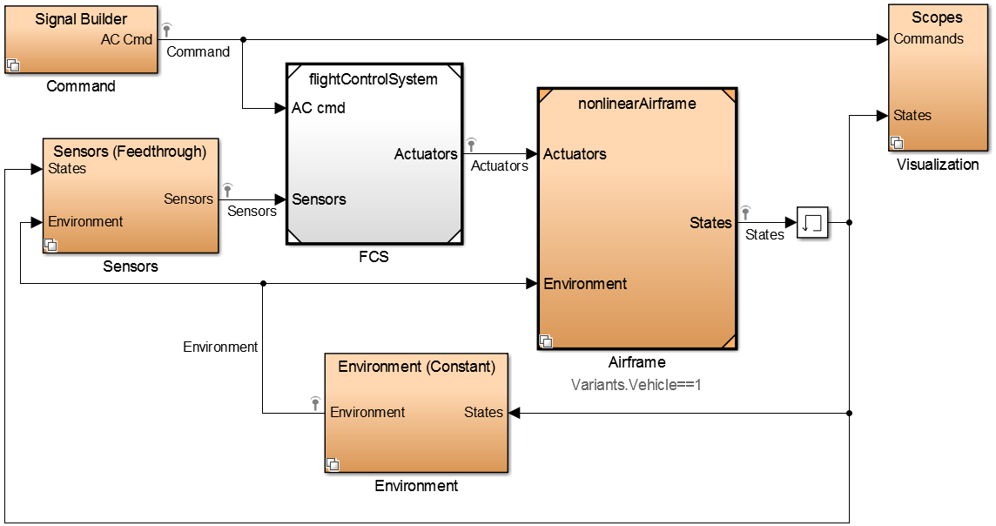
FlyNet: Autonomous Quadcopter Search and Rescue
Simulation
Input → Flight controller → Airframe

Slide 84
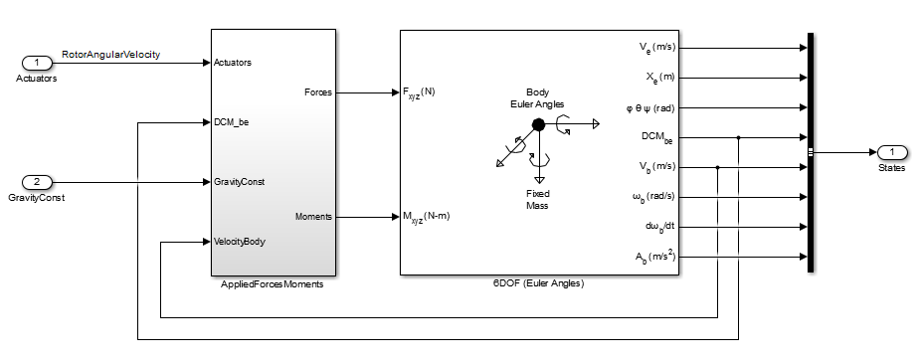
FlyNet: Autonomous Quadcopter Search and Rescue
Airframe Modelling
Use Simulink 6DOF block to simulate equations of motion in the quadcopter body coordinate frame.

Slide 85
FlyNet: Autonomous Quadcopter Search and Rescue
Applied Forces
Gravity
Motor thrust
Aerodynamic forces
Drag (lumped parameter model)
Ground effects
Applied Moments
Motor thrust
Other considerations
Rotational dynamics
Motor dynamics

Slide 86
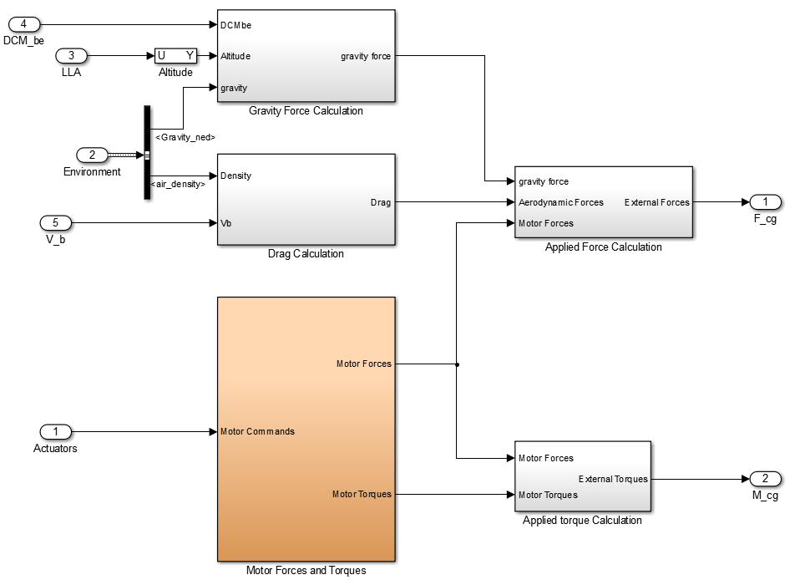
FlyNet: Autonomous Quadcopter Search and Rescue
Applied forces and moments

Slide 87
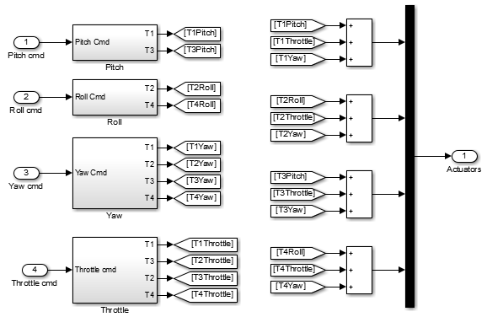
FlyNet: Autonomous Quadcopter Search and Rescue
Flight control (actuator outputs for given roll, pitch, yaw, and throttle commands

Slide 88
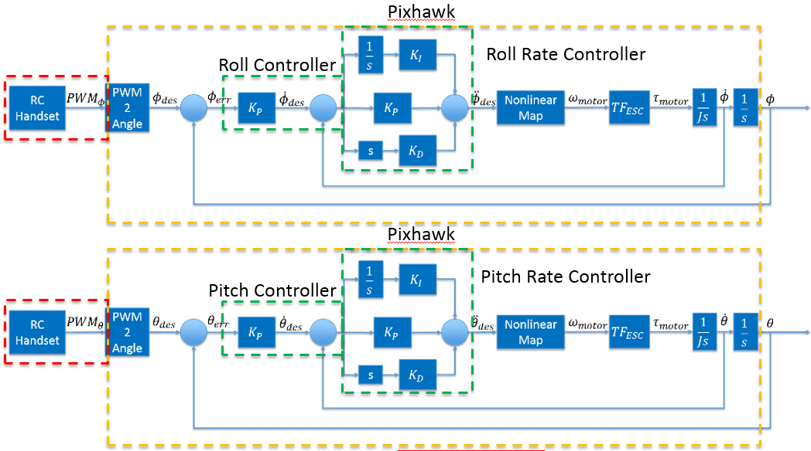
FlyNet: Autonomous Quadcopter Search and Rescue
Stabilize Mode

Slide 89
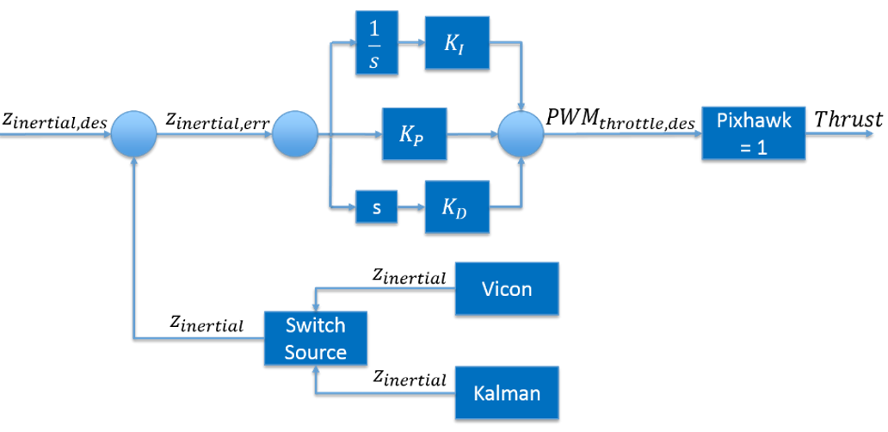
FlyNet: Autonomous Quadcopter Search and Rescue
Altitude Control

Slide 90
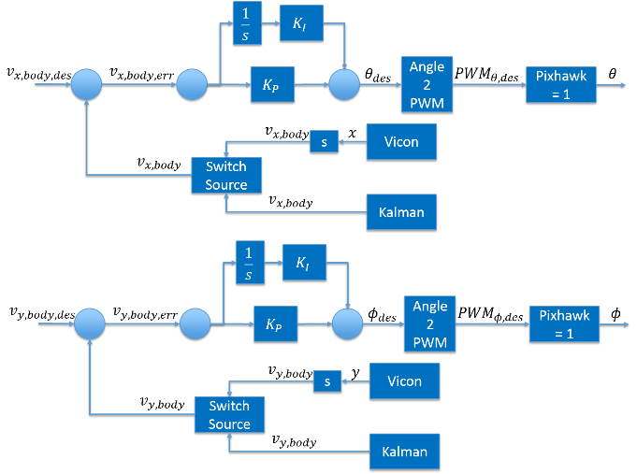
FlyNet: Autonomous Quadcopter Search and Rescue
Velocity Control

Slide 91
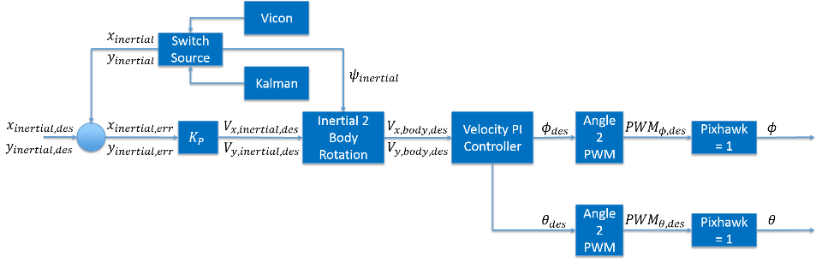
FlyNet: Autonomous Quadcopter Search and Rescue
Position Control

Slide 92
FlyNet: Autonomous Quadcopter Search and Rescue
Next steps
Test hardware to determine accurate coefficients
Motor thrust per (rotational velocity)²
Motor rotational velocity per PWM input
Quadcopter frame arm length
Quadcopter moment of inertia
Simulate Pixhawk controller in Simulilnk
Validate simulation against experimental flight data

Slide 93
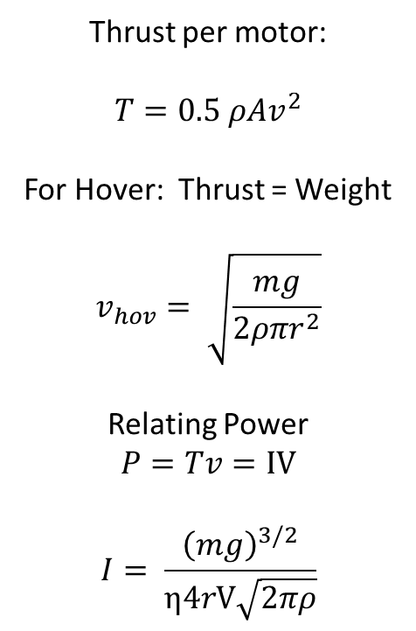
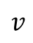
Motor Current Draw
Thrust per motor:
$$T=0.5 ρAv^{2}$$
For Hover: Thrust = Weight
$$v_{hov}= \sqrt{\frac{mg}{2ρπr^{2}}}$$
Relating Power
$$P=Tv=IV$$
$$I= \frac{{\left(mg\right)}^{3/2}}{η4rV\sqrt{2πρ}}$$
r
η
$$v$$
I,V

